Slide 1
Programming in
C
© Copyright Reserved for : MIIT Computer Education, Bargarh

Slide 2
Program & Language
Program : A Program is a set of logical instruction or information which arrange logically & Sequentially for producing any out put or any specific task
Language : It is the means of communication. The language can be classified into three category.
1. Machine Level Language
2. Assembly Level Language
3. High Level Language
Machine Level Language : It is the binary language completely depends upon two digits such as 0 & 1. It is otherwise known as first generation language.
© Copyright Reserved for : MIIT Computer Education, Bargarh

Slide 3
Language
Assembly Level Language : It is otherwise known as 2nd generation language. It uses the digits and special character like the keyboard symbol. Assembler is the software used to convert assembly language to machine language and vice versa.
High Level Language : It is uses the English like command, Keywords, all the characters and digits etc. It is otherwise known as the third generation language.
For Example
      C
      C++
      Visual Basic
      JAVA etc…
© Copyright Reserved for : MIIT Computer Education, Bargarh

Slide 4
C Language
In 1960 Ken Thompson developed a language known as BCPL (Basic Combined Programming Language) and later named it as B. “B” language was modified by Dennis Ritchie and was implemented by Bell Laboratories of USA in 1972. The new language was named C.
Now a day this language is much popular due to its desirable quality. It can perform huge amount of task within a few seconds.
Chorological Order of Development :
ALGOL CPL BCPL B C
1960 1963 1967 1970 1972
© Copyright Reserved for : MIIT Computer Education, Bargarh

Slide 5
C Language (Features)
C is a middle level language because it is provides good programming efficiency as compared to machine oriented language of low level language. It has a relatively good machine efficiency as compared to other high level language.
C is a block structured language with fundamental flow control constructions.
It is a simple, versatile, more expensive general purpose language.
It is a function oriented language.
It is also permits data conversion.
Dynamic storage allocation is possible in C.
Recursive function call is possible in C.
It is applied in System, Language Compilers and Interpreters.
© Copyright Reserved for : MIIT Computer Education, Bargarh

Slide 6
C Language (Some Reasons)
Learning C++, C# or JAVA is more harder without the knowledge of C as a beginner. Because it have things like Classes, Objects, Inheritance, Polymorphism, Templates, exception handling, reference etc.
C++, C#or JAVA make use of a principle called Object Oriented Programming (OOP) to organize the program. So you would need a good hold over the C Language.
One should learn C before C++, C# or JAVA because while using the frameworks and tools you would be still required the Core C language elements.
Major parts of popular operating systems like Windows, UNIX, Linux are still written in C.
© Copyright Reserved for : MIIT Computer Education, Bargarh

Slide 7
C Language (Some Reasons)
Mobile devices like cellular phones and palmtops have become rage of today. Also common consumer device like microwave ovens, Washing Machines and digital cameras are getting smarter by the day. This smartness comes from a microprocessor, an operating system and a program embedded in this devices are written by the language C.
You must have seen several professional 3D Computer games where the user navigates some object like say a spaceship and fires bullets at the inventers. These types many popular gaming frameworks have been built using C Language.
The Hardware interaction is also possible by the language C.
© Copyright Reserved for : MIIT Computer Education, Bargarh

Slide 8
Token
Token is an Individual Unit or group of the C Programming. It consists of most meaningful elements such as variable, constant, datatype, operators, etc…
© Copyright Reserved for : MIIT Computer Education, Bargarh

Slide 9
Variable
Variable is a quantity which may vary (Changes) during program execution. It is a memory Elements which allocates some memory space in the memory.
Rules for Naming a Variable
Variable is a combination of alphabets, digits or underscore.
Variable name must be within 32 characters.
It should be started from an alphabet.
Variable name does not support the blank space or any special symbol
like @, &, #, $, !, ^ etc Except (_) underscore.
It can be uppercase and lowercase both; Usually C variables are in
lowercase letters.
Keyword or reserve word are not used as variable.
We can declare more than one variable in a single line.
All the variable should be declare before the use inside in the program.
© Copyright Reserved for : MIIT Computer Education, Bargarh

Slide 10
Data Type
Datatype will be determine the kinds of data to be stored inside its associated variable. Various types of datatype has been provided in C language. They are…
DataType
User Defined
Inbuilt
Abstract
Structure
Union
Enumeration
Integral
Void
Floating
Pointer
Function
Array
Integer
Integer
Char
Float
Double
Signed
Unsigned
Signed
Unsigned
Short
Long
Short
Long
Short
Long
© Copyright Reserved for : MIIT Computer Education, Bargarh

Slide 11
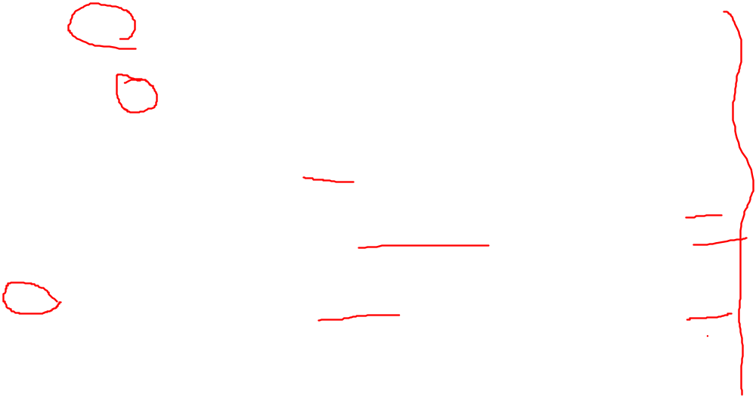
Type Modifiers
Data Type | Range | Bytes | Format
Signed Char Unsigned Char Short signed Int. Short Unsigned Int. Signed Int. Unsigned Int. Long signed Int. Long Unsigned Int. Float Double Long Double | -128 to +127 0 to 255 -32768 to +32767 0 to 65535 -32768 to +32767 0 to 65535 -2147483648 to +2147483647 0 to 4294967295 -3.4E38 to + 3.4E38 -1.7E308 to +1.7E308 -1.7E4932 to + 1.7E4932 | 1 1 2 2 2 2 4 4 4 8 10 | %c %c %d %u %d %u %ld %lu %f %lf %Lf
© Copyright Reserved for : MIIT Computer Education, Bargarh

